Slide 1

Sentiment-Aware Conversational AI for Mental Health Interventions
2410030511-Purnima
2410030443-Harshita
2410030445-Praneeta
2410030066-Aparna

Slide 2
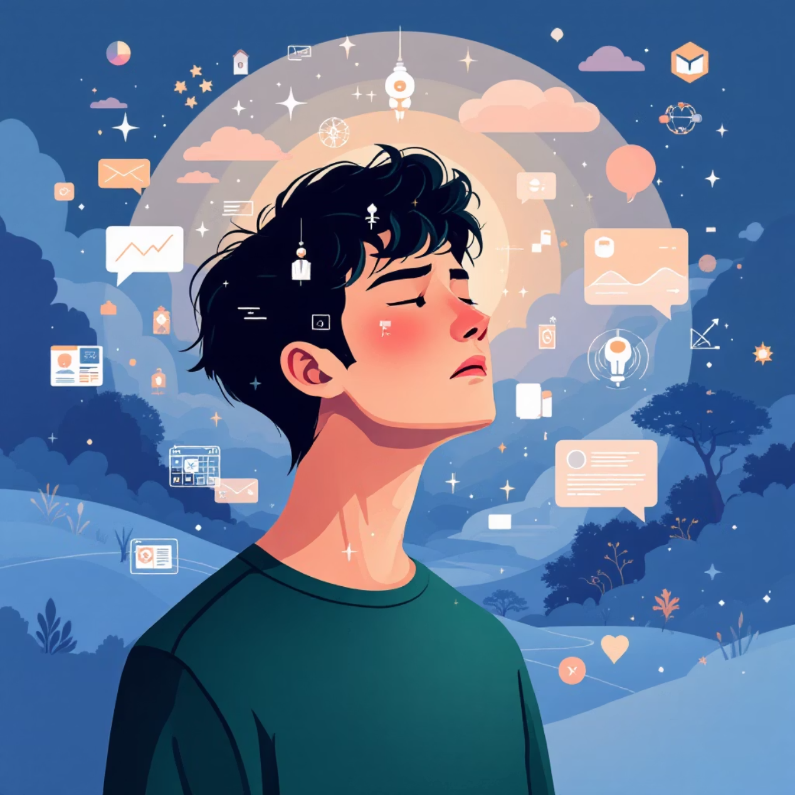
The Unspoken Challenge in Digital Mental Health
Mental health challenges like stress, anxiety, and loneliness are escalating globally, yet many existing digital solutions fall short. Traditional chatbot-based interfaces, while accessible, often feel clinical and impersonal.
Users struggle to form genuine connections.
There's a significant hesitation to express true emotions.
The reliance on explicit conversation can feel forced and unnatural.
Our motivation is clear: to move beyond these limitations and create a truly engaging, non-clinical, and safe space for emotional support.

Slide 3

Redefining Mental Wellness Through Play
Game-Based Immersion
Intuitive Emotion Inference
MindScape offers a revolutionary game-based system for mental health support. It's an environment where healing unfolds naturally, not through forced dialogue.
Unlike chatbots, MindScape infers emotions through subtle gameplay choices and interactions, removing the pressure of explicit communication.
Stigma-Free Engagement
Players experience a natural, immersive journey, free from the stigma often associated with traditional mental health interventions.

Slide 4

The Intelligence Behind the game play
Our system leverages advanced NLP and AI to create a truly adaptive experience, understanding and responding to emotional nuances in real-time.
Lexicon-Based Sentiment
We analyze text inputs and choices using sophisticated lexicons to gauge sentiment accurately.
Context-Aware Correction
AI algorithms refine emotion detection by understanding the broader context of player actions and dialogue.
Emotion Blending
MindScape recognizes and integrates mixed emotions, reflecting the complexity of human feelings.
Trajectory Prediction
Our AI anticipates emotional shifts, allowing the game to proactively adapt and offer timely support.

Slide 5

A World That Adapts To You
It's has unique features create a dynamic and supportive environment that responds directly to the player's emotional state.
Emotion-Driven Story Branching: Narrative paths dynamically adjust based on inferred emotions, creating a personalized journey.
Mood-Adaptive Visuals & Audio: The game world's aesthetics and soundscapes shift to reflect and influence player mood.
Grounding Mini-Games: Integrated exercises like breathing and focus activities offer immediate coping mechanisms.
Emotion Memory Artifacts: In-game collectibles or elements visualize and acknowledge the player's emotional journey, fostering self-awareness.

Slide 6


Upholding Privacy and Ethics
It is built on a foundation of trust, ensuring user privacy and ethical data handling are paramount.
Anonymous Gameplay
No Personal Data Stored
No personal logins or identifiable data are required, ensuring complete anonymity.
We do not store any personal or medical information, prioritizing user confidentiality.
Abstract Numeric Patterns
User Control
Emotions are processed and stored as abstract numeric patterns, never linked to an individual.
Players retain full control, with the ability to pause or reset emotion tracking at any time.

Slide 7
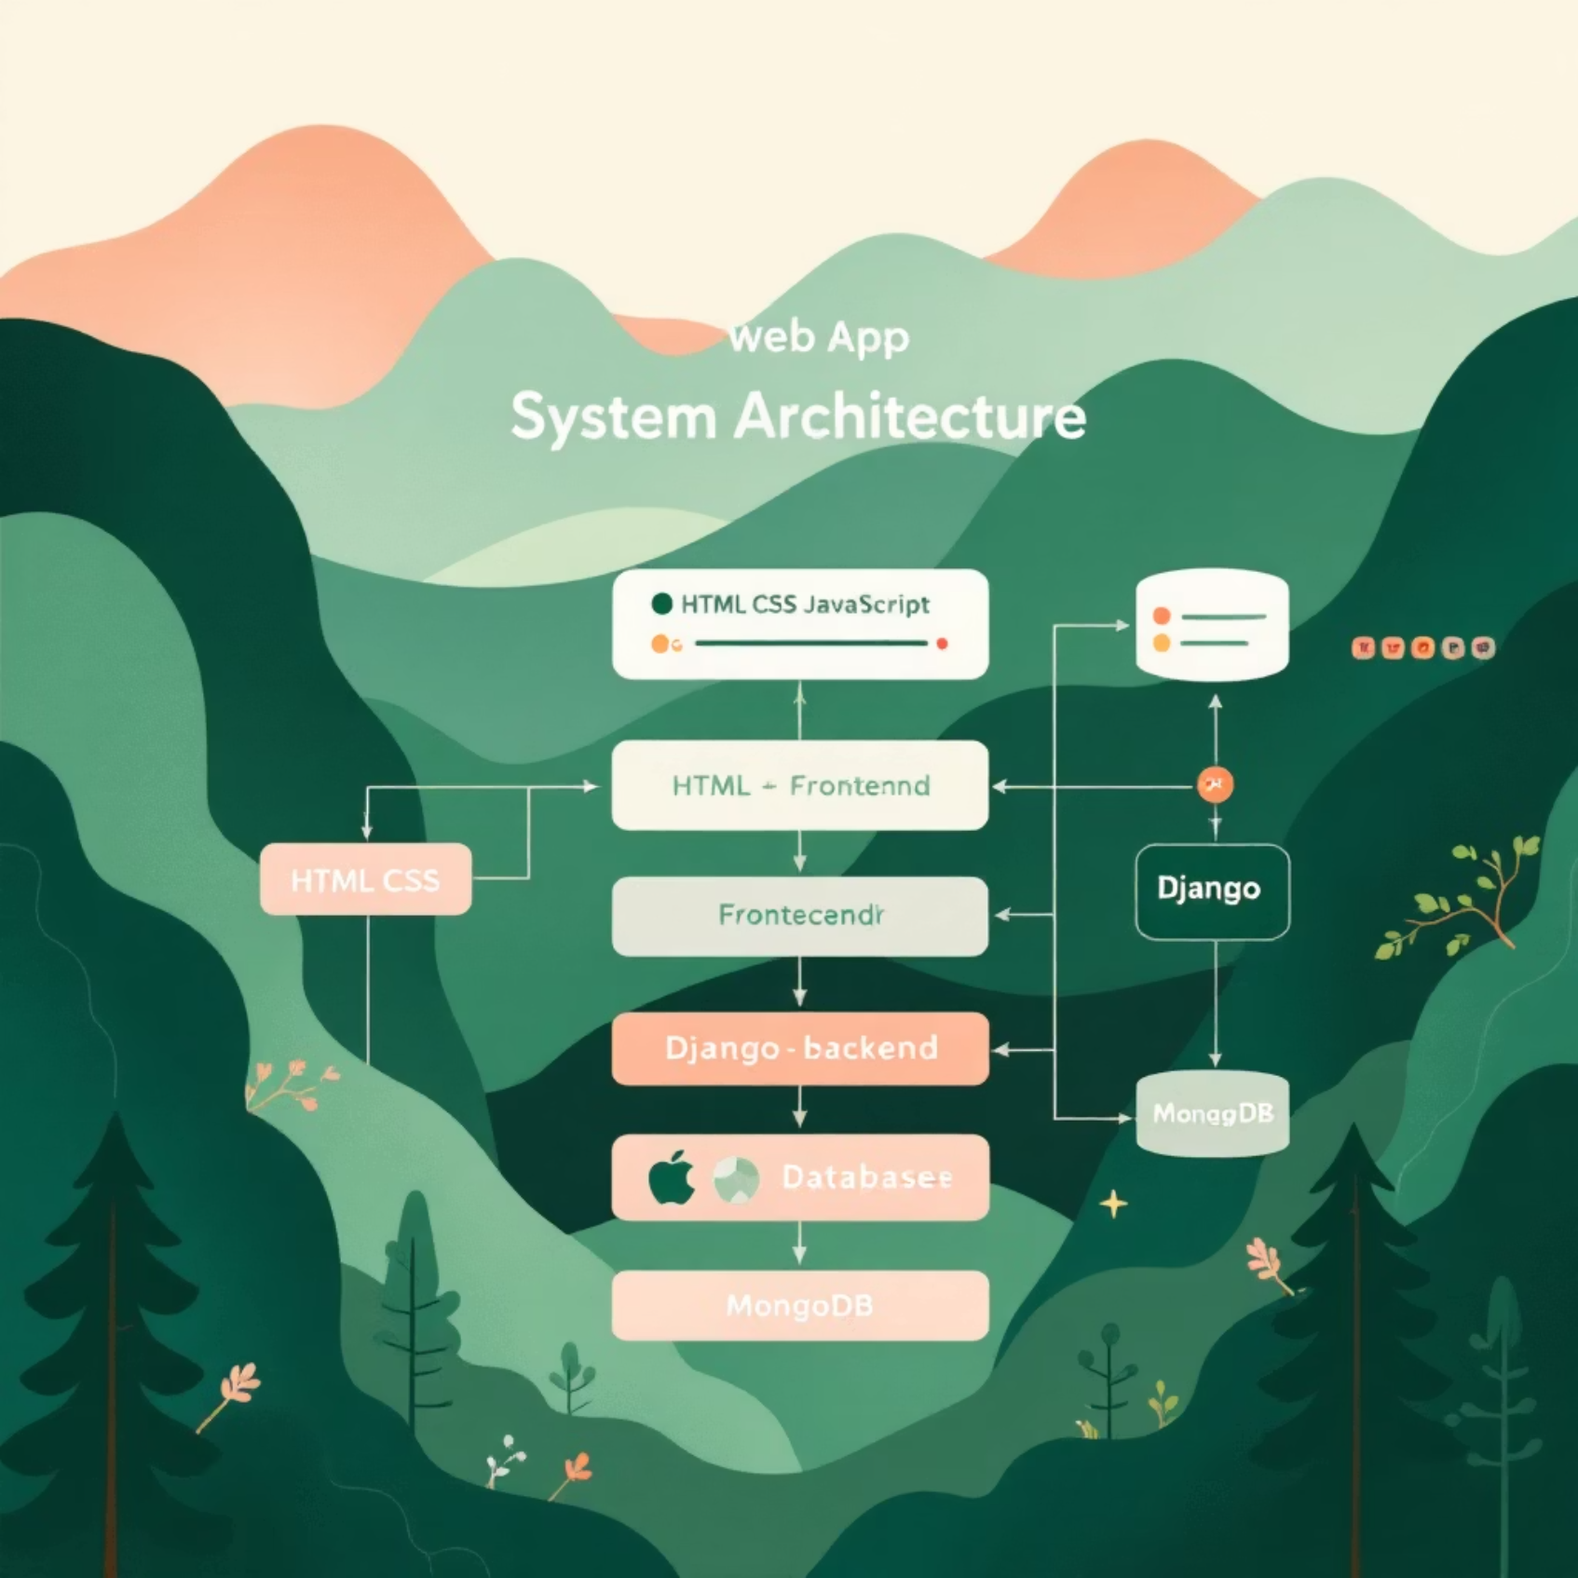
Robust and Scalable Architecture
Technical foundation is designed for efficiency, accessibility, and future growth.
Frontend: Developed with modern web technologies: HTML, CSS, JavaScript, ensuring broad compatibility and a rich user experience.
Backend: Powered by Django, providing a secure, robust, and scalable server-side framework.
Database: Utilizing MongoDB for flexible, high-performance data storage, ideal for handling abstract emotional patterns.
Our architecture supports lightweight NLP & AI algorithms, making the application responsive and efficient. As a web-based solution, it's inherently scalable and cost-effective to implement and maintain.

Slide 8

Shaping the Future of Mental Wellness
MindScape offers a compelling vision for digital mental health support, seamlessly integrating cutting-edge technology with empathetic design.
1
A Novel Approach
It stands as a unique alternative to traditional chatbot-based systems, offering genuine engagement without the clinical feel.
2
Interdisciplinary Synergy
MindScape harmoniously combines AI, NLP, interactive gaming, and rigorous privacy principles.
3
Ethical & Engaging
We are committed to providing an ethical, engaging, and socially relevant platform for mental wellness.
4
Real-World Impact
With strong potential for real-world application, MindScape is poised to make a significant positive impact on mental health support globally.

